Slide 1
CMDS- the prestigious project of GCDA

Slide 2
KNOWLEDGE SHARING SESSION
Presentaion 1
15TH JULY 2016
CELL IV
SHIJI.E.CHANDRAN
N.R.OMANA
GREESHMA.P.G
BINCY ELIZABETH

Slide 3
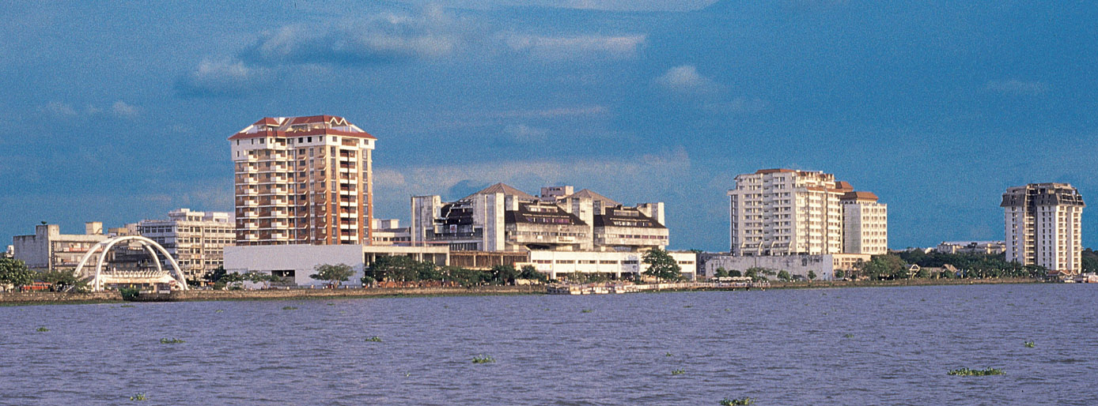
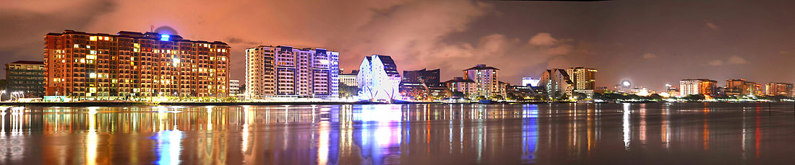
MARINE DRIVE

Slide 4
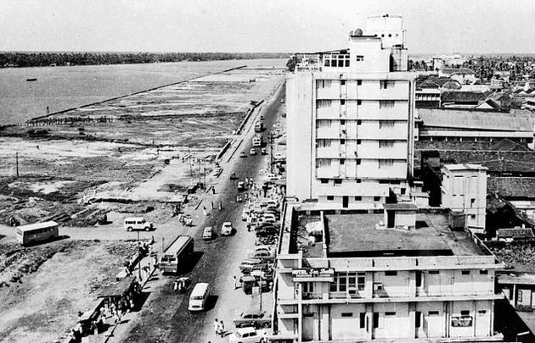
Until the 1980s, the Shanmugham Road was the literal marine drive with the Kochi lake and the adjoining Arabian Sea to its west.

Slide 5
COCHIN MARINE DEVELOPMENT SCHEME
The present Marine Drive is one of the most significant projects that GCDA has ever undertaken as part of face lift to Kochi.
The project was taken up by the then Cochin Town Planning Trust, the forerunner of the present GCDA.
The CMDS was a project that focused on the water front development. This scheme includes the land reclaimed from the Vembanad Lake during 1980s.
The scheme area extends from immediate north of the Tanker Jetty upto Tata canal which is the boundary with Gosree Island Development Authority land.

Slide 6
The total land of 36.68 acres was reclaimed in two stages- an area of 19.44 acres South of Railway Canal in 1970s and 19.24 acres North of Railway canal afterwards.
Sri Kuldip Singh from New Delhi was appointed as the Consultant Architect for the scheme during 1984 and prepared a master plan for the first stage upto the railway canal, utilizing the area keeping provision for maximum public utility.
The Government approved the scheme prepared by him as per GO (Rt) No. 3790/ LA&SWD dt 26/11/79. As per that the total FAR was 1.5. As per this it was planned to construct all the buildings by GCDA itself.

Slide 7
During 1992, GCDA to retrieve from the acute financial situation, it was decided to go for privatisation and started selling plots for constructing buildings according to the control drawings supplied by the Authority.
While redesigning the scheme as requested, the area of 5.12 acres in front of the Police Camp and Offices were kept as free open area and FAR in the remaining plots was increased marginally. The revised scheme works out a total FAR of 1.26.
Subsequent to the completion of reclamation of second stage, the scheme was again revised. Later the scheme revised for the total area was approved by the Government as per GO (Rt) No.188/ 2000/ LSGD dt 13/1/2000. In this this the Global FAR for the entire project area was limited to 1.70.

Slide 8
Unique Feature of the Scheme
The unique aspect of the scheme is the concept of GLOBAL FAR, and is fixed as 1.7 by the Government. (as per GO (Rt) No.188/ 2000/ LSGD dt 13/1/2000. )
That is the ratio of the total built-up area to the whole scheme area as a unit is limited to 1.7.
Hence creation of more open space was made possible by increasing the permissible FAR of the developable plots.
The total FAR utilised so far is calculated as 1.17

Slide 9
Proposals and Achievements
Development and extension of Rajendra Maidan, Childrens Park, Subhash Park, Marine Drive Ground, Ferry stations were done.
The much popular Walkway with three attracting bridges crossing Mullassery Canal, Market Canal and Railway Canal viz., CHEENAVALAPPALAM, MAZHAVILPPALAM and KETTUVALLAPPALAM were made possible through this scheme
Due to the above developments this area became a notable tourist place.
Rest of the land was earmarked for commercial and residential uses. In the commercial area, a service road of minimum 8m width adjacent to Shanmugham Road is provided.

Slide 10
Salient Features
SCHEME BASED ON A MASTER PLAN
CONCEPT OF GLOBAL FAR INTRODUCED
WALKWAY CREATED
PARK ADDED
SUBHASH PARK EXTENDED
SHANMUGHAM ROAD CONVERTED TO SIX LANE DUAL CARRIAGE WAY
FERRY STATION ENLARGED
BOAT JETTIES ADDED
ARCHITECTURAL CONTROLS ENFORCED.
BUILT CAPTIVE SEWAGE TREATMENT PLANT
HIGH PRIORITY GIVEN TO PUBLIC FACILITIES

Slide 11
CMDS- Master Plan

Slide 12
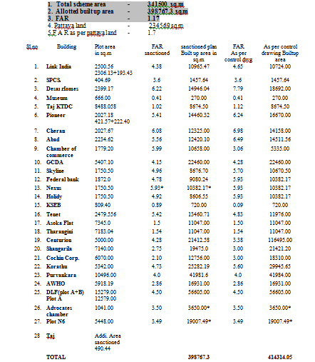
Details of plot allotted

Slide 13
Present Scenario
Major portion of the building construction in the scheme is almost completed.
The extension of the 12m wide walkway from AWHO building, north of KINCO jetty upto the Tata canal and the ‘Kettuvallppalam’ across Railway canal was recently opened to public.

Slide 14
Plot Owner Details
  Rajendra Maidan (GCDA)
  Subhash ChandraBose Park
  Boat Jetty, KSRTC Stand etc
  Children’s Park
  Link India
  Sahithya Pravarthaka Co operative Society
  Desai Homes
  Museum
  Taj GateWay
  KTDC
  Pioneer Towers
  Alliance
  Baypride
  Kerala Chamber of Commerce
  GCDA Shopping Complex (GCDA)
  Federal(Plot 3)
  Skyline(Plot 4)
  K D Gopalakrishnan(Plot 5) - Vacant
  Holiday Ventures(Plot 6)

Slide 15
  Marine Drive Ground (GCDA)
  KSEB SubStation (KSEB)
  Sewage Treatment Plant (GCDA)
  Tenet (Swapnil Enclave) (Plot 7)
  Bunk Shops (GCDA) - Reconstruction Proposed
  KINCO Jetty (KSINDC)
  Ashoka Residential Apartment (GCDA project)
  AWHO Residential Apartment (Prasanna Vihar)
  Tharangini Residential Apartment(GCDA project)
  Centurion (Plot N1A)
  Abad Marine Plaza (Plot N1B)
  Corporation office site (Plot N2) (Kochi Corporation)
  Koroth(Plot N3)
  Puravankara (Plot N4)
  DLF (Plot N5) - Vacant
  Owned by GCDA (Plot N6) - Vacant

Slide 16
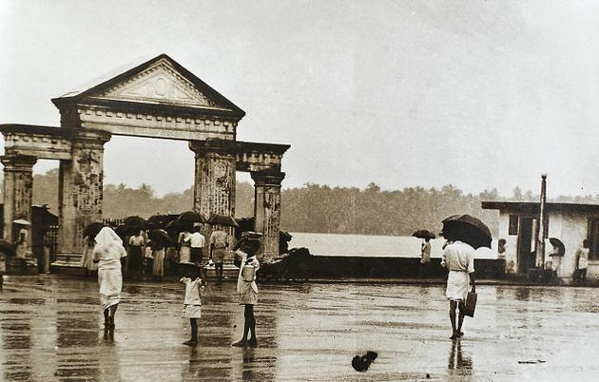
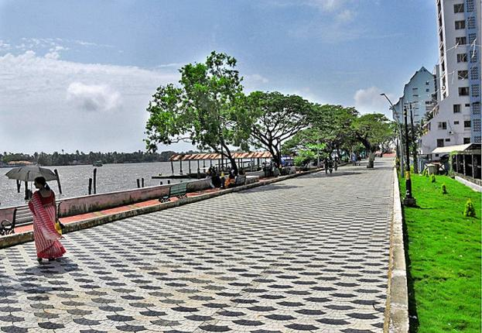
NOW
THEN

Slide 17
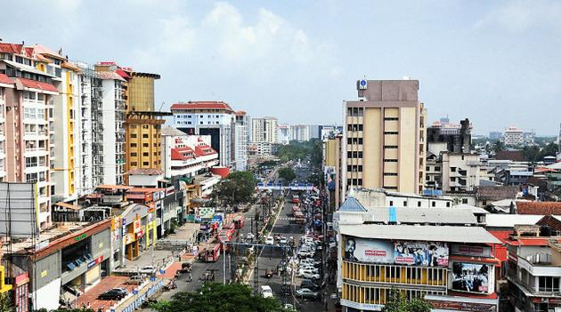
then
NOW

Slide 18
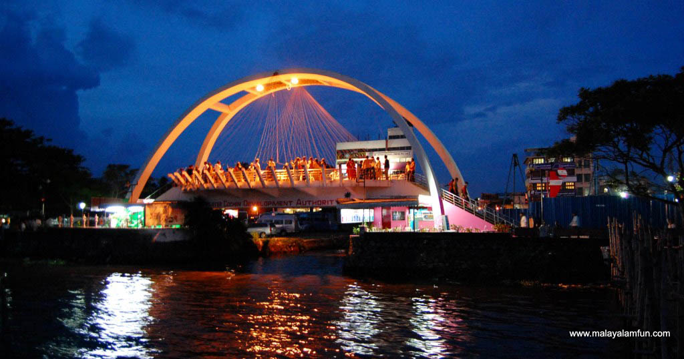
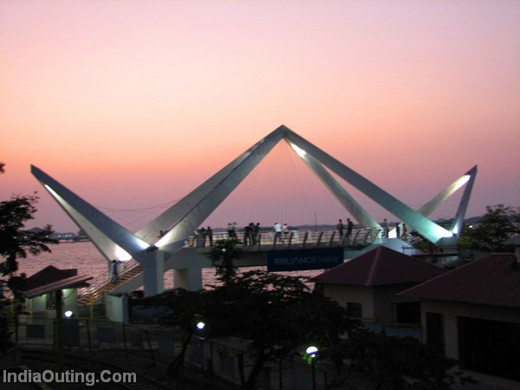
RAINBOW BRIDGE
CHEENAVALA BRIDGE

Slide 19
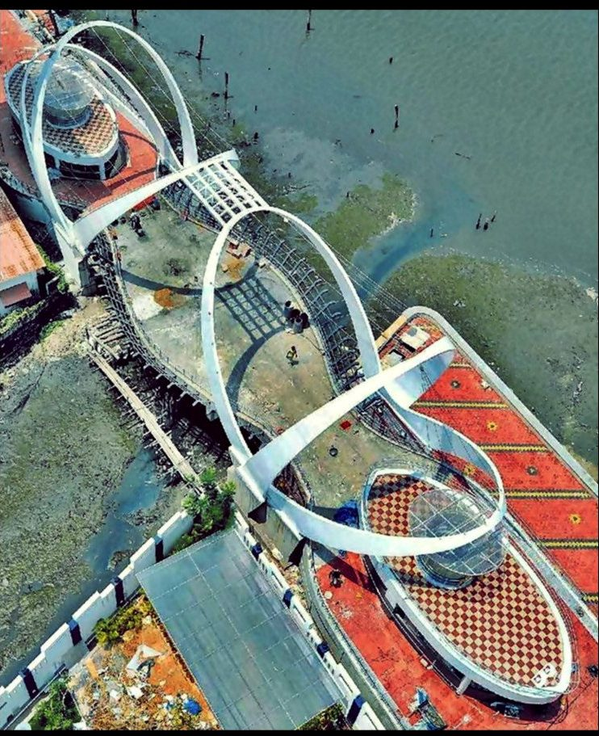
KETTUVALA PALAM

Slide 20
PROJECTS UNDER CONSIDERATION IN GCDA LAND
TETHERED HELIUM BALLOON
GATEWAY ARCHES AT LINK ROADS
TOURIST BOAT JETTY
MARINE DRIVE GROUND BEAUTIFICATION
COMMERCIAL COMPLEX AT BUNK AREA
TUNNEL MARINE AQUARIUM
ROPEWAY

Slide 21
THANK YOU

